Slide 1

Neural Network Perceptron
By: Er. Aarti Sharma
Associate Professor
Department :CSE

Slide 2
Topics Covered:
How Artificial Neural Network Works
Introduction to Perceptron
Single Layer Perceptron
Multilayer Perceptron

Slide 3
How Artificial neural network works:
Artificial Neural Network can be best represented as a weighted directed graph, where the artificial neurons form the nodes.
The association between the neurons outputs and neuron inputs can be viewed as the directed edges with weights.
The Artificial Neural Network receives the input signal from the external source in the form of a pattern and image in the form of a vector.
These inputs are then mathematically assigned by the notations x(n) for every n number of inputs.

Slide 4
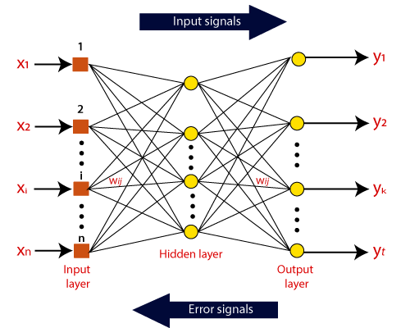
Each of the input is multiplied by its corresponding weights.
These weights normally represent the strength of the interconnection between neurons.
All the weighted inputs are summarized inside the computing unit.
If the weighted sum = 0,then bias is added to make the output non-zero . Bias has the same input, and weight equals to 1.
Weighted inputs can be in the range of 0 to positive infinity.
The total of weighted inputs is passed through
the activation function.
The activation function refers to the set of transfer
functions used to achieve the desired output.

Slide 5
Perceptron
Neural Network is based on the Perceptron.
A simple model of a biological neuron in an artificial neural network is known as Perceptron.
Perceptron is a single layer neural network,or a neural network is a multi-layer perceptron.
Perceptron is a binary classifier, and it is used in supervised learning.
A function that can decide whether or not an input which is represented by a vector of number belongs to some specific class is known as binary classifiers.
The binary classifier is a type of linear classifier.
A linear classifier is a classification algorithm which makes its predictions based on a linear predictor function combining a set of weight with the feature vector.
The perceptron algorithm was designed to categorizing subjects into one of two types, classify visual input and separating groups with a line.
Classification is a key part of image processing and machine learning.

Slide 6
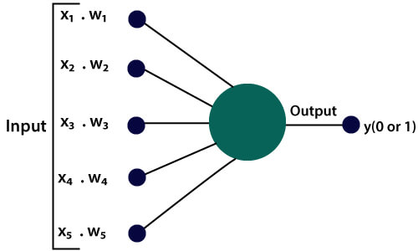
Perceptron
The Perceptron works on three simple steps which are as follows:
a) In the first step, all the input x are multiplied with their weights denoted as K. This step is essential because the output of this step will be input for the next step.

Slide 7
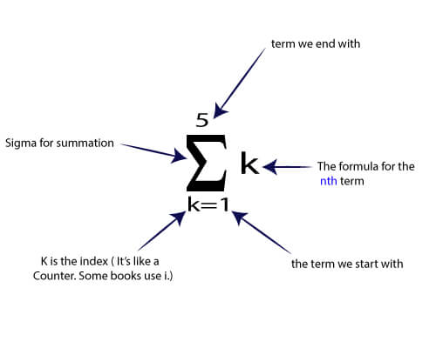
b) Next step is to add all the multiplied value from K₁ to K_{n}. It is known as the weighted sum. This weighted sum will be treated as an input for the next step.

Slide 8
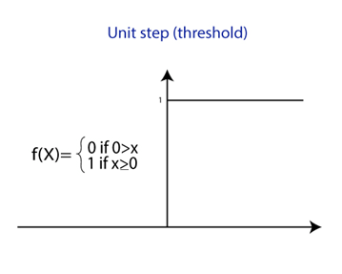
c) In the next step, the weighted sum, which is calculated from the previous step, is applied to the correct activation function.
For example
A unit step activation function

Slide 9
There are two types of architecture.
The functionality of artificial neural networks as follows-
Single Layer Perceptron
Multi-Layer Perceptron

Slide 10
Single Layer Perceptron
The perceptron is a single processing unit of any neural network.
Perceptron is a linear classifier, and is used in supervised learning. It helps to organize the given input data.
A perceptron is a neural network unit that does a precise computation to detect features in the input data.
Perceptron is mainly used to classify the data into two parts. Therefore, it is also known as Linear Binary Classifier.
Our goal is to find a linear decision function measured by the weight vector w and the bias parameter b.

Slide 11
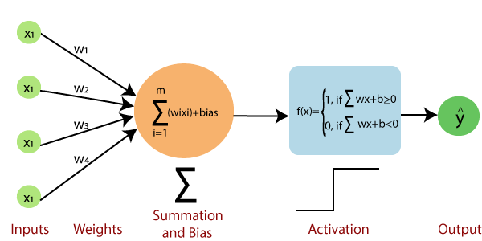
The single vector perceptron is calculated by :
Calculating the sum of the input vector multiplied by the corresponding element of the vector, with each increasing the amount of the corresponding component of the vector by weight.
The value that is displayed in the output is the input of an activation function.
It is limited to perform a pattern classification with two classes.
The goal of perceptron model is to classify correctly the set of input into any one of the two classes.
The decision rule for classification:
If y= +1
Then assign points represented by i/p
(X1…Xn) to class1.
If y= -1
Then assign points represented by i/p
(X1…Xn) to class2.

Slide 12
Limitation of Single Layer Perceptron
In case of two dimensional perceptron the two classes are sufficiently separated from each other to draw a hyper plane as a decision boundary.
But if the two classes are allowed to move too close to each other then the become non linearly seperable in such situation it not computable by single layer perceptron.

Slide 13
Multi layer perceptron
It is defined as the most complex architecture of artificial neural networks.
It is formed from multiple layers of the perceptron.
MLP networks are used for supervised learning format.
A multilayer perceptron (MLP) is a feed forward artificial neural network that generates a set of outputs from a set of inputs.
An MLP is characterized by several layers of input nodes connected as a directed graph between the input and output layers.
MLP uses backpropagation for training the network.

Slide 14
These network are called multilayer perceptrons .
They are fully connected.
Signal flow in forward direction from left to right
The signal propagation in this network:
Function signal: Input signal propagated in forward n/w and produces output signal . (left to right)
Error signal :propagates backward (right to left) originates from output layer propagate for error correction.

Slide 15
Characteristics of MLP:
Single layer perceptron is hard limiting , but MLP is smooth due to non linearity (sigmoid function).
Due to presence of multiple hidden layers n/w can able to learn complex task by supervised learning .
Limitations of MLP:
Need large theoretical analysis which is difficult due to non linearity and high degree of connections (hidden layers).
Difficult to decide input patterns represented by hidden neurons.
Due to use of back propagation algorithm , it is difficult , complex to use in supervised method in MLP.

Slide 16
THANK YOU!

